Slide 1
Hand in lab report from before spring break

Slide 2
V.O.D Compounds of Blood
https://www.youtube.com/watch?v=R-sKZWqsUpw
Notes:
2 mins

Slide 3
Learning Intentions
I can describe the shape, function, and origin or red blood cells, white blood cells, and platelets.
I can list the major compounds of blood plasma
I can describe capillary-tissue fluid exchange.
Notes:
5 min
Have Students read through notes

Slide 4
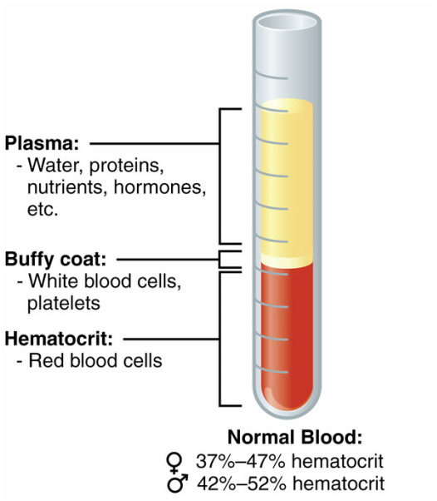
Main Components of Blood
Notes:
10 mins

Slide 5
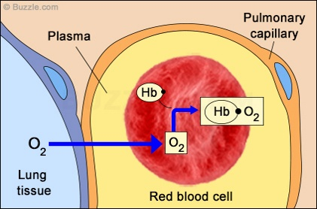
Red Blood Cells: Erythrocytes
What is the function of the
Biconcave disk shape of
Red blood cells?

Slide 6
Journal Reflection: Identify examples of interconnectivity
https://www.youtube.com/watch?v=GVU_zANtroE
For example: Diseases occur when one or more body systems fail to maintain homeostasis
Notes:
10 mins

Slide 7
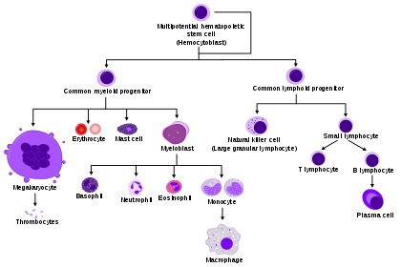
White Blood Cells
Notes:
10 mins

Slide 8
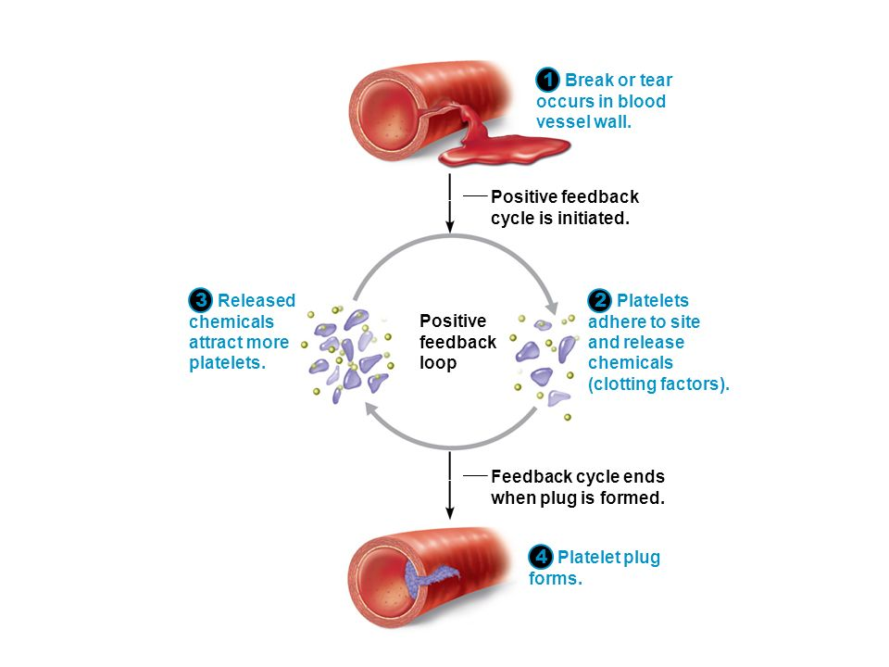
Platelets – For Protection

Slide 9
Learning Activity – Due Friday, April 6th
Draw 3 images of the heart to demonstrate your understanding of the anatomy. Refer to learning intentions for structures to label.
Cross Section Image 1
Transverse Section Image 2
Frontal Image 3
When you finish your drawings create a video describing the form and function, and upload to your freshgrade portfolio. In your video your goal is to demonstrate your understanding of form and functions of the structures of the heart.
Use these images and the class model to help you:
https://docs.google.com/presentation/d/1nXGz7Ew_T5hx2G0xWlk0XgywGv0U7n5arVwVZ-pyY90/present?slide=id.i5

Slide 10
Done Early – Check out this article
https://www.thoughtco.com/capillary-anatomy-373239
(link is on my website)
Assignment:
What is the flow of blood in the capillaries controlled by? How do these structures work?
What controls fluid exchange?
What causes the osmotic pressure?
Summarize the net flow of fluid at the beginning of the capillary bed, middle of the capillary bed and end of the capillary bed.

Slide 11
Looking Forward
April 6th – drawing assignment and video DUE
Lesson on Fetal Circulation
April 10th – Function and Components of the lymphatic system
April 12th – Quiz (compounds of blood, fetal circulation and lymphatic system)
Reminder to Presenters

