Slide 1
Take Away Task: Answer key to WS is posted
Notes:
1 key questions for each learning intention from last class

Slide 2
Why do endurance athletics train at high altitude?
https://www.youtube.com/watch?v=wmkO8oWyg8Y
Notes:
Think Pair Share Before Video?
How is this different then using the syntetic EPO erythropoietin

Slide 3
Learning Intentions
I can explain how the body controls breathing

Slide 4
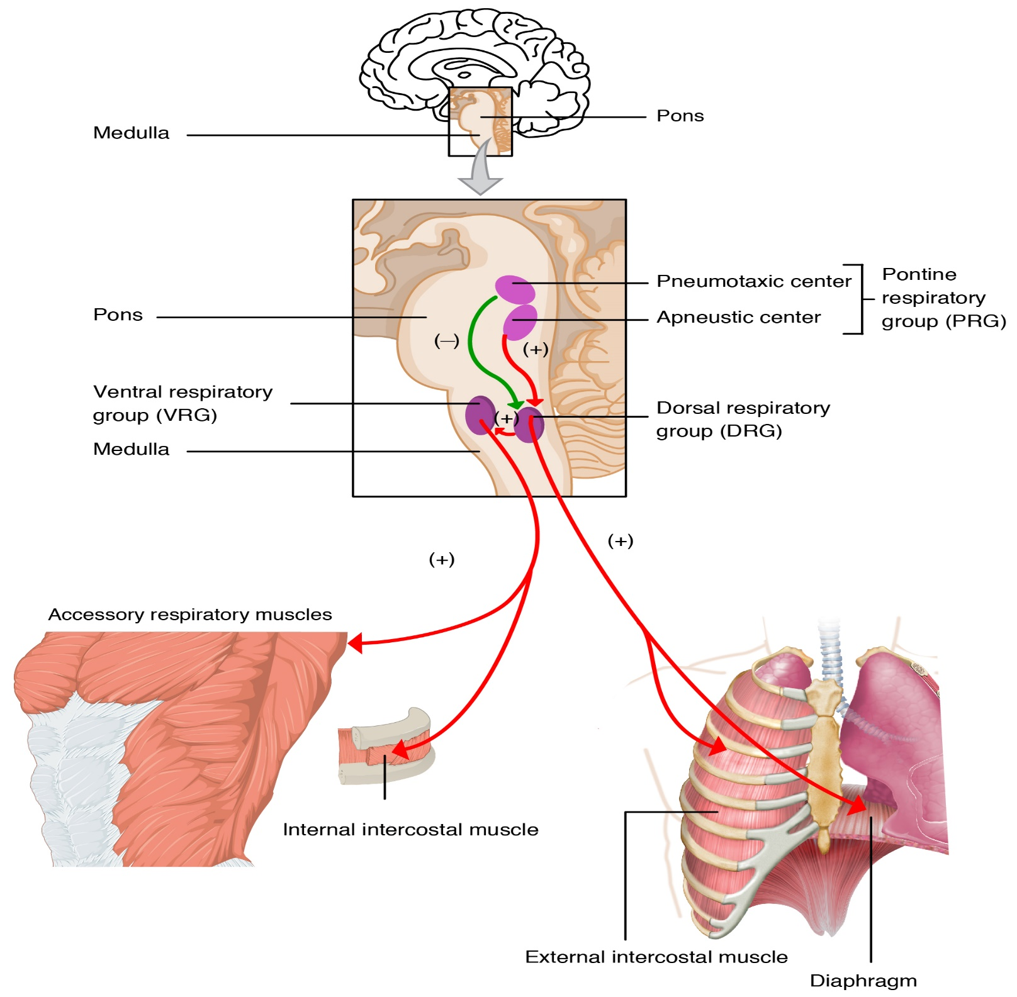
Involuntary Control of Breathing

Slide 5
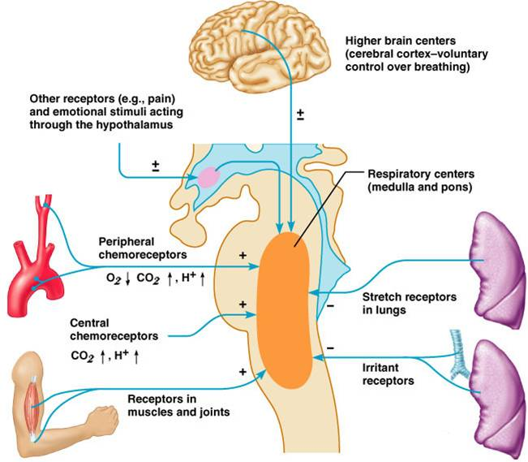
Chemoreceptors

Slide 6
Control of Breathing Overview
https://www.youtube.com/watch?v=IXyZTzEoOtQ

Slide 7
Could you benefit from learning breathing exercises?
Ted Ed:
https://www.youtube.com/watch?v=4Lb5L-VEm34

Slide 8
Respiration Test: Friday April 27th
I can identify the structures of the respiratory track including the convection zone and respiration zone
I can describe the mechanism of breathing including inhalation and ventilation; and draw a schematic representing these processes in relation to the pulmonary and systemic circulations.
I understand the importance of bulk flow and diffusion in respiration
I can identify and describe the processes of internal and external respiration
I can explain what drives diffusion of gases at the lungs and at the tissues
I can draw a graph to represent the shifts that occur in relation to environmental conditions and affinities of oxygen
I can explain how the body controls breathing
Notes:
Student choice
Key cards or two Colum notes for each learning intention
Create your own questions and answer

