Slide 1
Exam Prep Day
Review “Big Ideas”
Studying Techniques

Slide 2
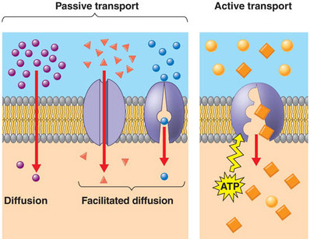
Cells

Slide 3
DNA: Protein Synthesis
https://www.youtube.com/watch?v=2BwWavExcFI

Slide 4
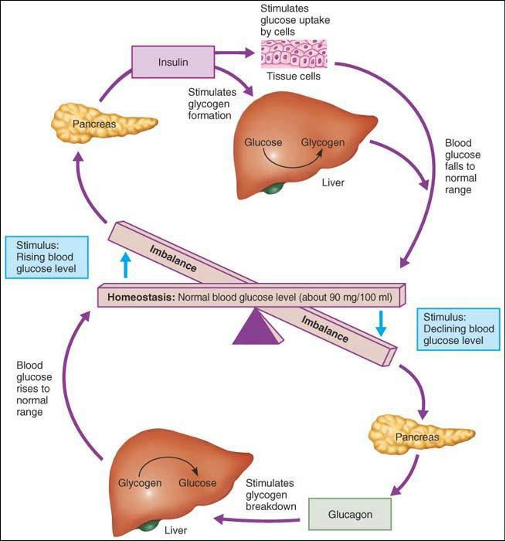
Homeostasis

Slide 5
Organization
https://www.youtube.com/watch?v=T4x7-2HKtJ0&pbjreload=10

Slide 6
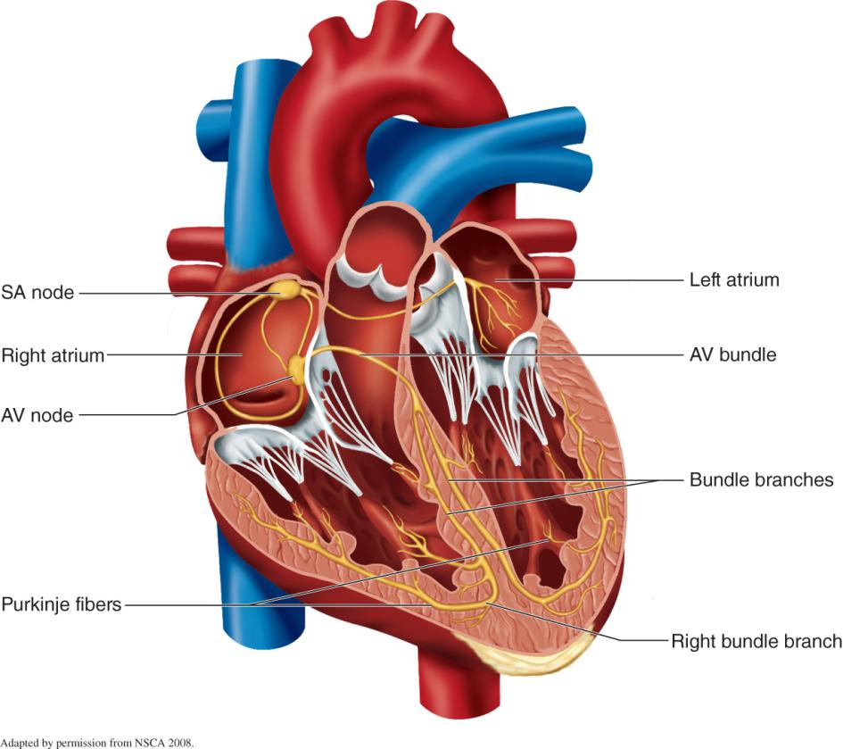
Regulation of Heartbeat

Slide 7
Intrinsic Control of Heart Activity: Cardiac Conduction System
Spontaneous rhythmicity: special heart cells generate and spread electrical signal
Sinoatrial (SA) node
Atrioventricular (AV) node
AV bundle (bundle of His)
Purkinje fibers
Electrical signal spreads via gap junctions
Intrinsic heart rate (HR): 100 beats/min
Observed in heart transplant patients (no neural innervation)

Slide 8
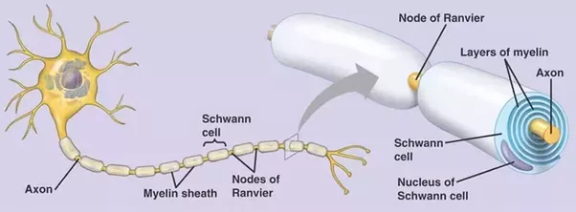
Cell Structure and Function

Slide 9
Study Smart
https://www.youtube.com/watch?v=p60rN9JEapg
Small Study Chunks (Schedule)
Focussed Study – Flashcards (try Quizlet app)
Specific Goals (write your own learning intentions)
Teach someone else
Practice
Put AWAY the phone

