Slide 1
Checkpoint

Slide 2
V.O.D
https://www.youtube.com/watch?v=9iMGFqMmUFs&t=104s
What happens when you drink to much or to little water?

Slide 3
Essential Question: How does the urinary system contribute to homeostasis?

Slide 4
How does the urinary system contribute to homeostasis?
Blood pH
Water and Salt balance
Hormone Regulation
Blood volume/pressure

Slide 5
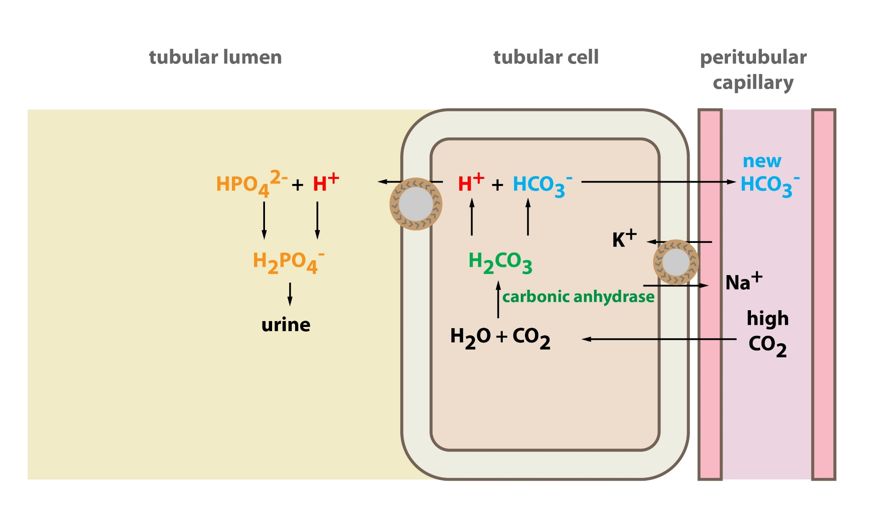
pH Balance

Slide 6
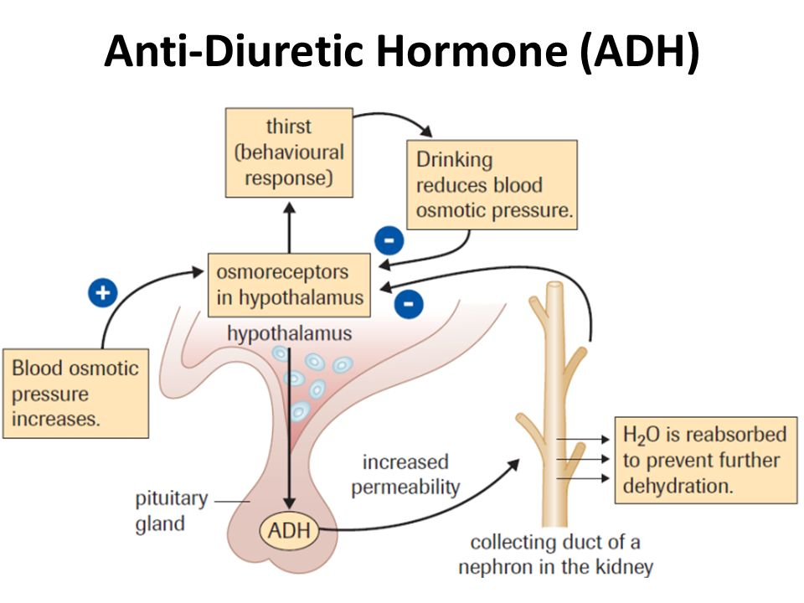
Salt Water Balance

Slide 7
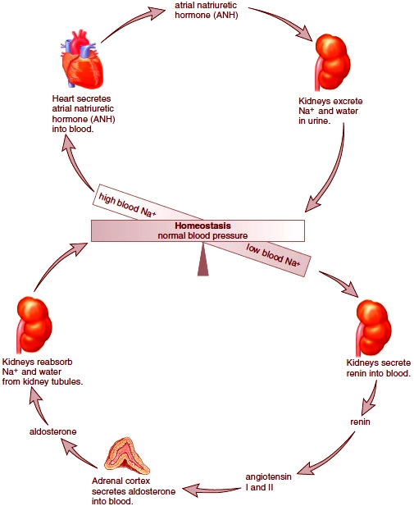
Salt Water Balance

Slide 8
Looking Forward!
Unit Test Excretion May 15th
Biology Final Exam Friday May 25th
Attendance is mandatory
Exam Policy: If illness, accident, or family affliction causes a student to miss the exam the student must contact teacher before exam to request a deferred exam. Documentation from a health professional to support the request is required.

Slide 9
In Order to Prepare
Review Learning Intentions
Study Options: Cue cards, two column notes, create your own practice questions and answers, practice drawing diagrams

