Slide 1
Student Presentations

Slide 2
V.O.D What do the kidney’s do? Main Functions?
https://www.youtube.com/watch?v=FN3MFhYPWWo

Slide 3
Learning Intentions
I can list and explain the main functions of the urinary system
I can define osmoregulation and excretion
I can describe the reactions that produces metabolites (nitrogenous wastes) and steps the body takes to eliminate them.
Notes:
Students read through notes
Highlight and underline new words
Have a partner ask you questions that you read about

Slide 4
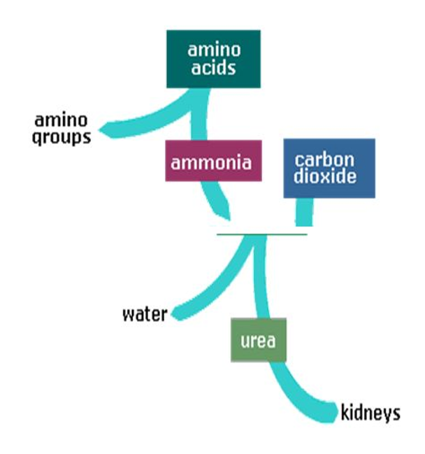
Main Functions Of Urinary System
Excretion
Filters out metabolites and eliminates them from the body through kidneys.
Maintain ionic and osmotic equilibrium.

Slide 5
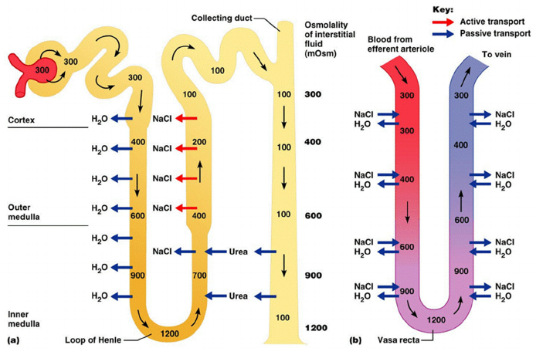
Main Functions Of Urinary System
2. Maintaining Water-Salt Balance
Regulates the concentration of NaCl in the blood which controls blood volume (due to osmosis) and blood pressure (due to blood volume).

Slide 6
Main Functions Of Urinary System
3. Maintain pH Levels
Can secrete H+ or reabsorb HCO3 to increase/decrease pH as needed.

Slide 7
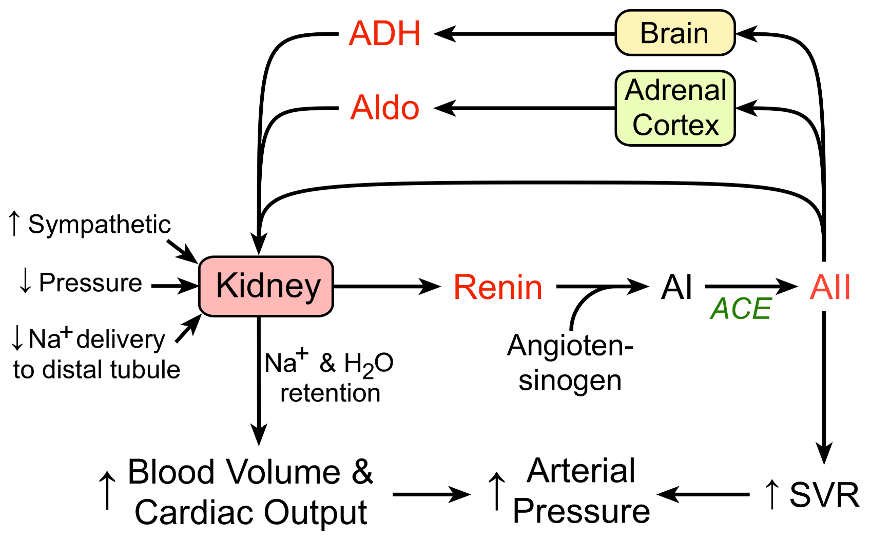
Main Functions Of Urinary System
4. Hormone Secretion
Secrete Renin: causes release of aldosterone from adrenal glands, which increase absorption of Na+ by kidneys.

Slide 8
Learning Activity: what do you think of lab created kidneys?
Read article
Underline and define key words
Discuss what you read with a partner
Develop 2 new questions that you now have

