Slide 1
Student Presentations

Slide 2
Learning Intentions
I can explain the stages of Spermatogenesis
I can identify the main structures of a sperm cell
I can identify the secretion and function of the seminal vesicles, prostate, and bulbourethral (Cowper's) gland
I can describe hormone regulation in the male reproductive system

Slide 3
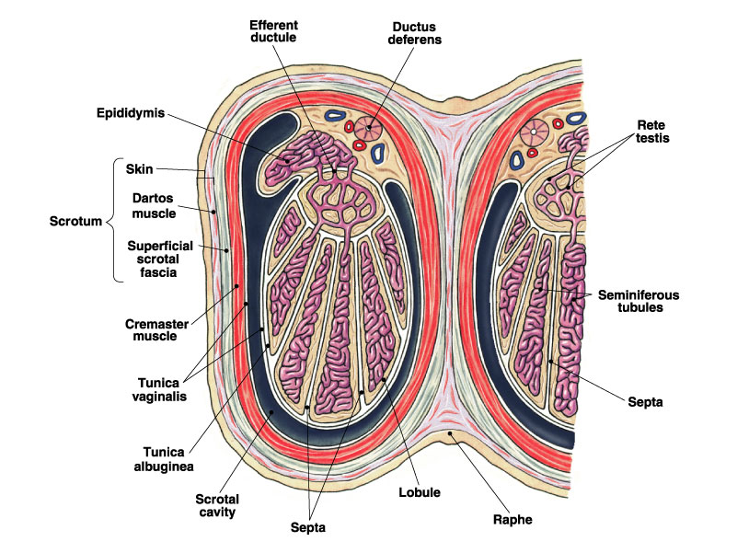
Spermatogenesis
The scrotum helps regulate the temperature of the testes by holding them closer or further away from the body.
Spermatogenesis is the production of sperm, or spermatozoa, the male gamete.

Slide 4
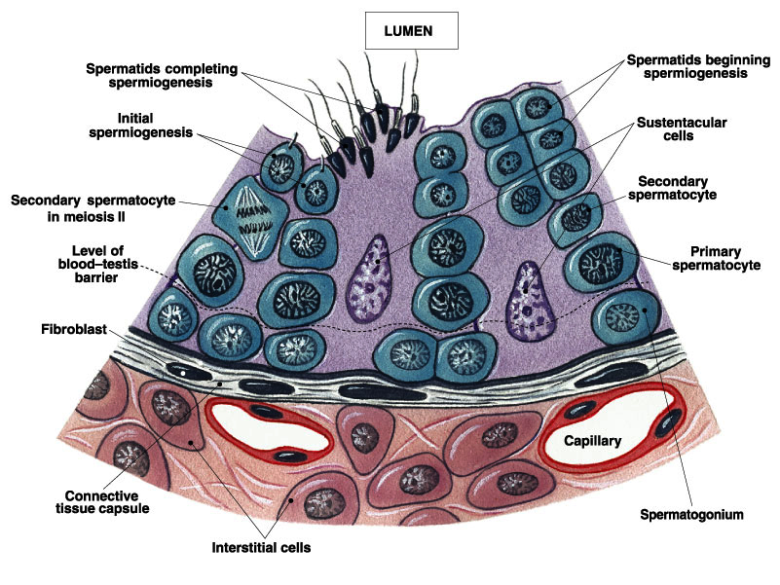
Spermatogenesis
The first step in spermatogenesis is a mitotic division of the spermatogonium.
One of the daughter cells remains, to replace the original spermatogonium, while the other cell (now called a primary spermatocyte) undergoes meiosis.
Notes:
The immature germ cell in the male is referred to as the spermatogonium.
These cells are located just under the basement membrane of the seminiferous tubules, between adjoining sustentacular (Sertoli) cells.
Since sperm production continues throughout adult life and at the peak, 100-200 million sperm can be produced daily, the spermatogonia are constantly renewed.
The first step in spermatogenesis is a mitotic division of the spermatogonium. One of the daughter cells remains, to replace the original spermatogonium, while the other cell (now called a primary spermatocyte) undergoes meiosis.

Slide 5
Spermatogenesis
http://highered.mheducation.com/sites/dl/free/0072421975/196644/spermatogenesis.html

Slide 6
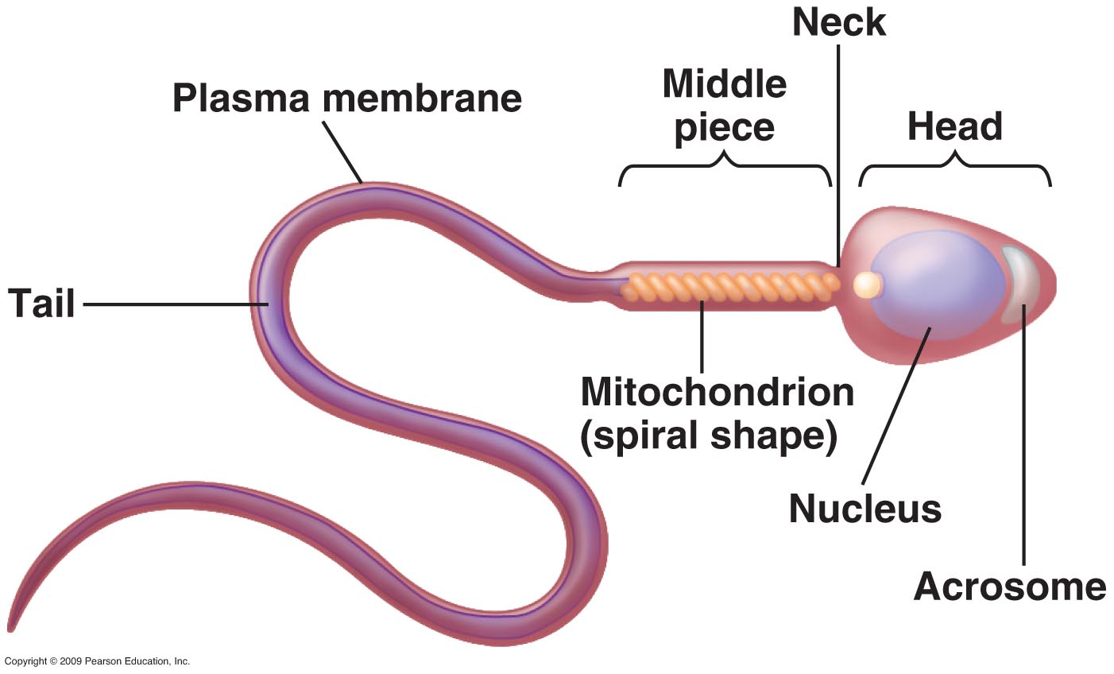
Structure of Sperm

Slide 7
Contents of Semen
Sperm leave the male during ejaculation in a fluid called semen which controls pH, nutrient levels, and hormone levels.
Gland | Secretion | Function
Seminal Vesicles | Fructose/ nutrients | Energy source
Prostate | Basic fluid | Increase pH of semen
Bulbourethral (Cowper’s) Gland | Viscous fluid | Increase thickness

Slide 8
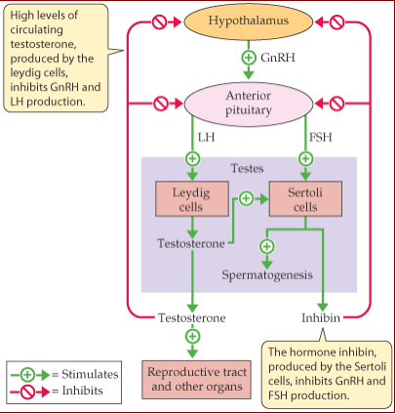
Hormone Regulation

Slide 9
Learning Task
1. Complete Female and Male Hormone Comparison Sheet
2. Study for Test on June 12th
Need some practice: Check These Out
http://media.pearsoncmg.com/intl/ema/ema_uk_he_wickens_biopsych_2e/07_sexual/activities/7_6_2_01.htm
http://www.johnwiley.net.au/highered/interactions/media/Continuity/content/Continuity/c2a/bot.htm

