Slide 1
V.O.D Why do women have periods?
https://www.youtube.com/watch?v=cjbgZwgdY7Q&feature=youtu.be

Slide 2
Learning Intentions
I can identify the anatomy of the female and male reproduction systems.
I can describe the function of each structure

Slide 3
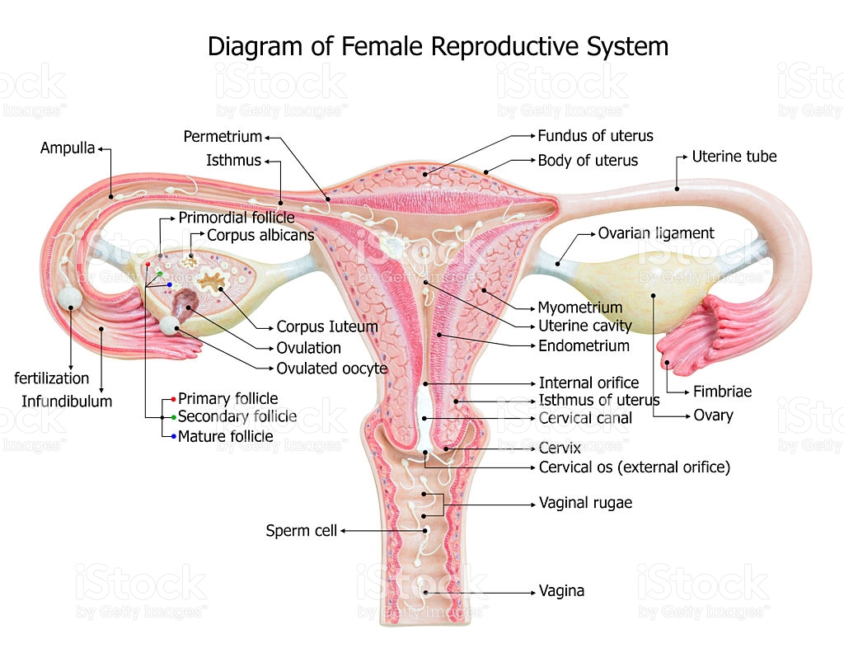

Slide 4
Follicle Development
https://www.youtube.com/watch?v=nLmg4wSHdxQ

Slide 5
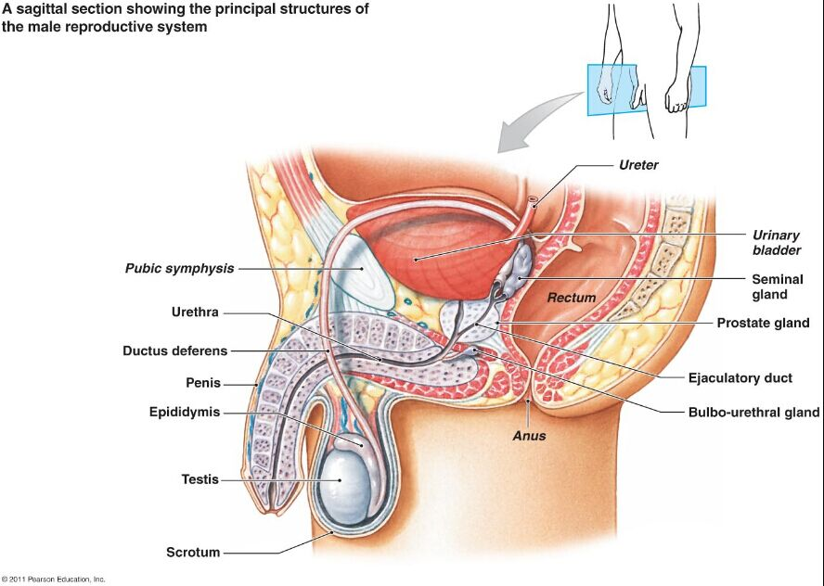
Male Reproductive Anatomy

Slide 6
Pathway of Sperm
https://www.youtube.com/watch?v=HPH4bVKaU4Y

Slide 7
Learning Activity
Male and Female Anatomy: Structure and Function Worksheet
Assessment Vote – project or quiz?
Presentations – June – must be completed next week? June 4th, 6th or 8th

