Slide 1
Learning Intentions
I can identify the structures of the respiratory track including the convection zone and respiration zone
I can describe the mechanism of breathing including inhalation and ventilation; and draw a schematic representing these processes in relation to the pulmonary and systemic circulations.
I understand the importance of bulk flow and diffusion in respiration

Slide 2
What do the lungs do?
https://www.youtube.com/watch?v=8NUxvJS-_0k

Slide 3
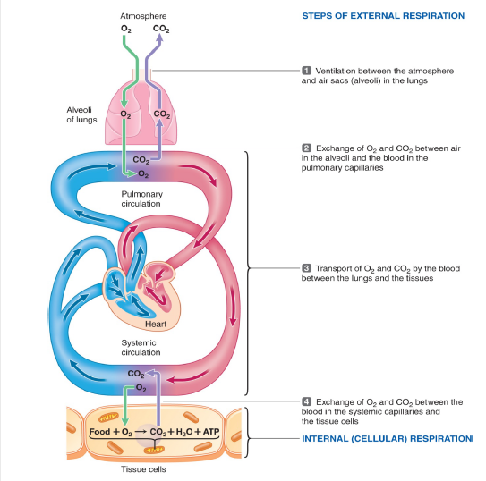
PROCESSES UNDERLYING HUMAN RESPIRATION
BULK FLOW vs DIFFUSION
Ventilation & transport of blood gases in the blood stream are accomplished by bulk flow & depend on the difference in total pressure.
Gas exchange at the lungs & tissues is accomplished by diffusion & depends on the difference in the partial pressure of a given gas.

Slide 4
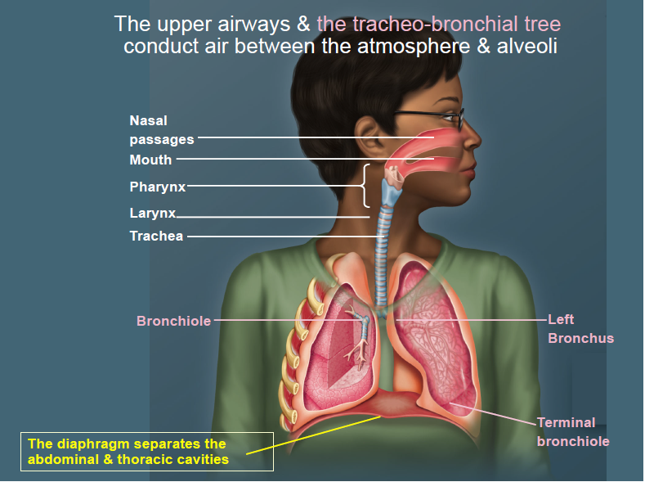

Slide 5
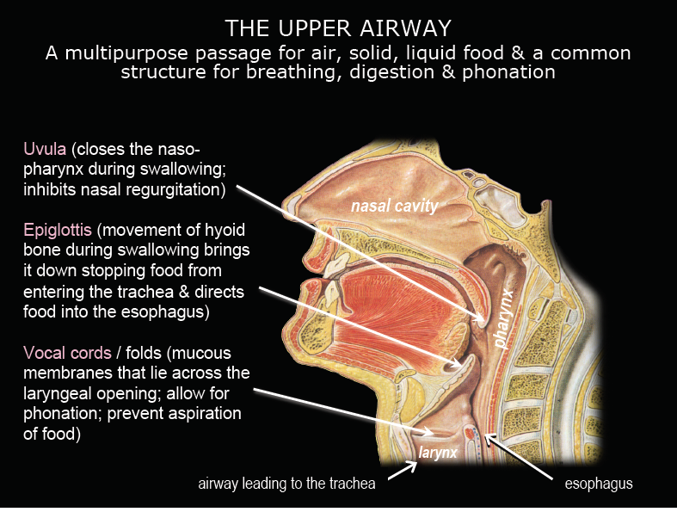

Slide 6
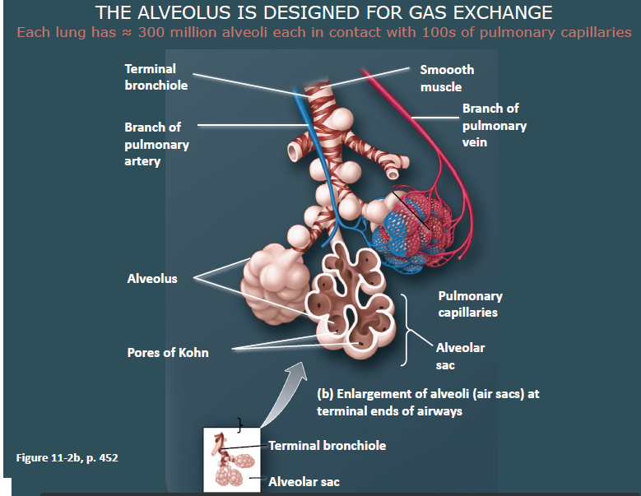

Slide 8
Exploring an Issue in Healthcare Assignment
Goal: To gather information from all stakeholders and prepare recommendations to the Parliament of Canada regarding the right to the healthcare system to withhold certain medical treatments or therapies from smokers with smoking-related diseases and the responsibility for the cost of such treatments or therapies.
Group Project: 4-6 people per group
Due Date: Thursday April 26th

