Slide 1
Checkpoint
Define bulk flow and diffusion. Draw a diagram to enhance your answer.
2. Describe the process of ventilation including the appropriate volume and pressure changes.

Slide 2
Learning Intentions
I can identify and describe the processes of internal and external respiration
I can explain what drives diffusion of gases at the lungs and at the tissues
I can draw a graph to represent the shifts that occur in relation to environmental conditions and affinities of oxygen

Slide 4
Example Partial Pressures

Slide 5
Partial Pressures

Slide 6
Notes:
Label Internal and External Respiration

Slide 7
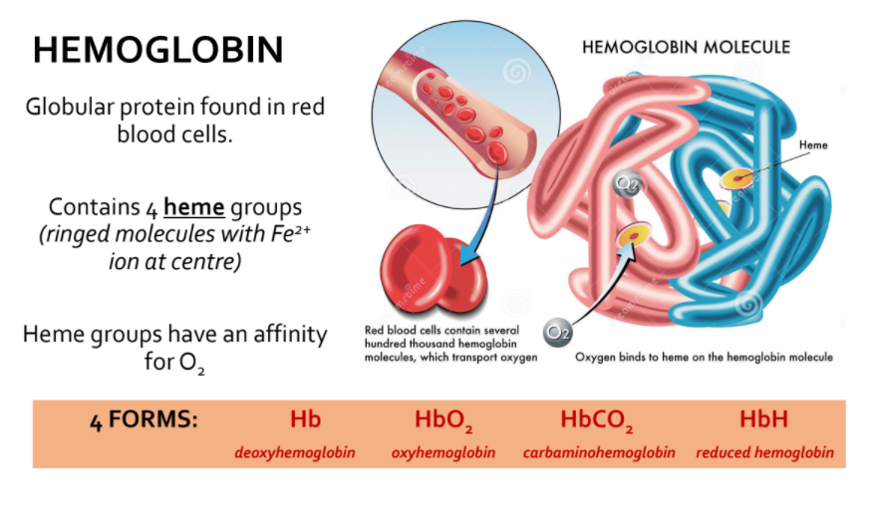

Slide 9
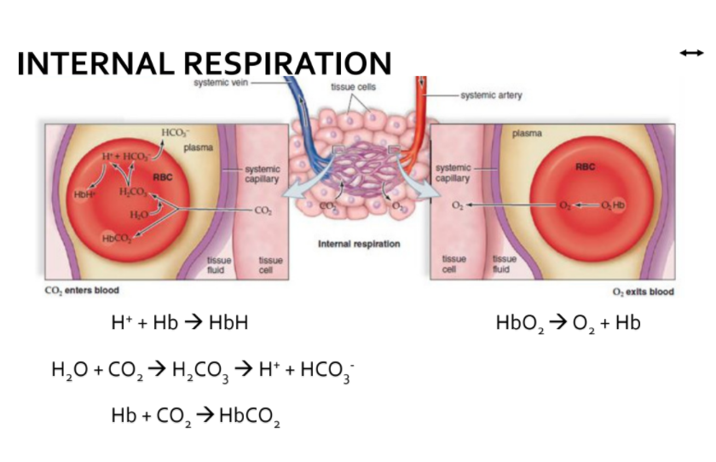

Slide 10
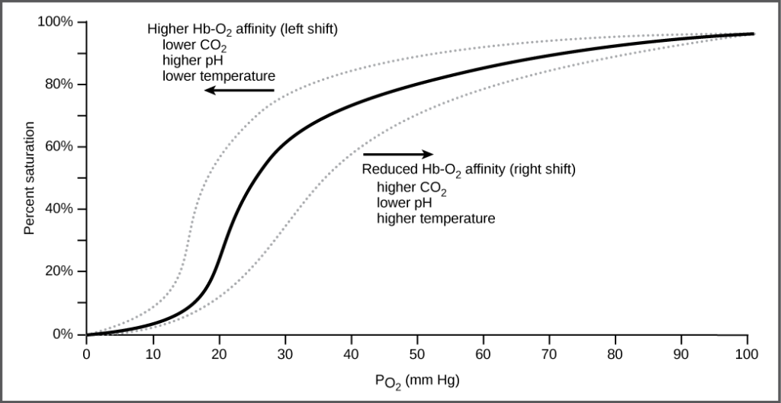
Notes:
At the tissues: reduced affinity for O2, lower pH is causes by increase in Co2 that relates with H2o to produce H2CO3 (carbonic acid) quickly separates into bicarbonate ions, HCO3- and hydrogen H+.
Hemoglobin is able to bind to H+
In the lungs the H+ ions separate from hemoglobin molecules and diffuse into the blood plasma. H+ relates with HCO3- to form CO2 and water

Slide 11
Learning Activity
Complete Internal and External Respiration Questions
Watch TedTalk – Could you benefit from learning breathing exercises?
https://www.youtube.com/watch?v=4Lb5L-VEm34

